Slide 1
Stoked Oats
A history in 11 slides
Notes:
Cover: editable images on Canva. Click here > https://www.canva.com/design/DAEu3-QRsSk/sPuiIK5F0otyAkXZ8jef4g/edit?utm_content=DAEu3-QRsSk&utm_campaign=designshare&utm_medium=link2&utm_source=sharebutton

Slide 2
What i’ve learned over 10 years:
To build a brand, you need time or money. If you have both, you’re off to a Great start, but if you don’t, then be ready for an ultramarathon.
If you want to sprint, go buy crypto.

Slide 3
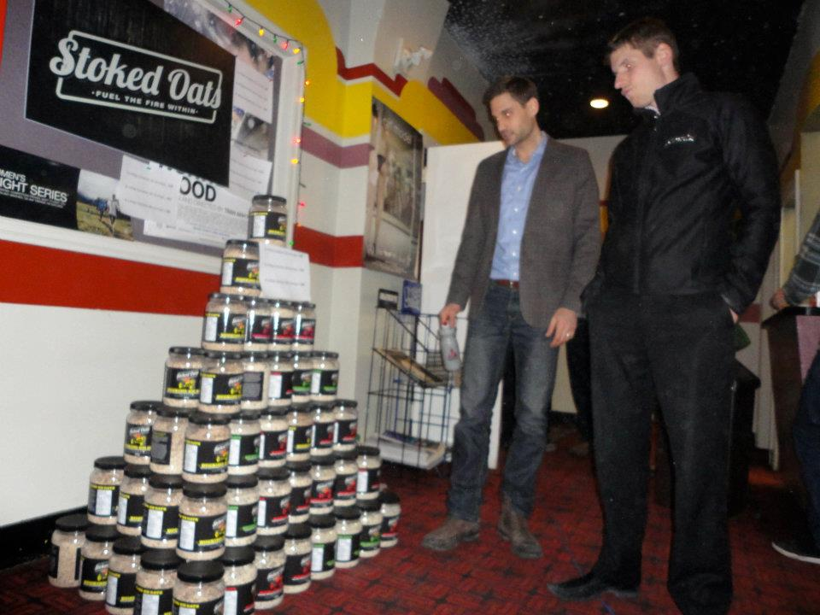
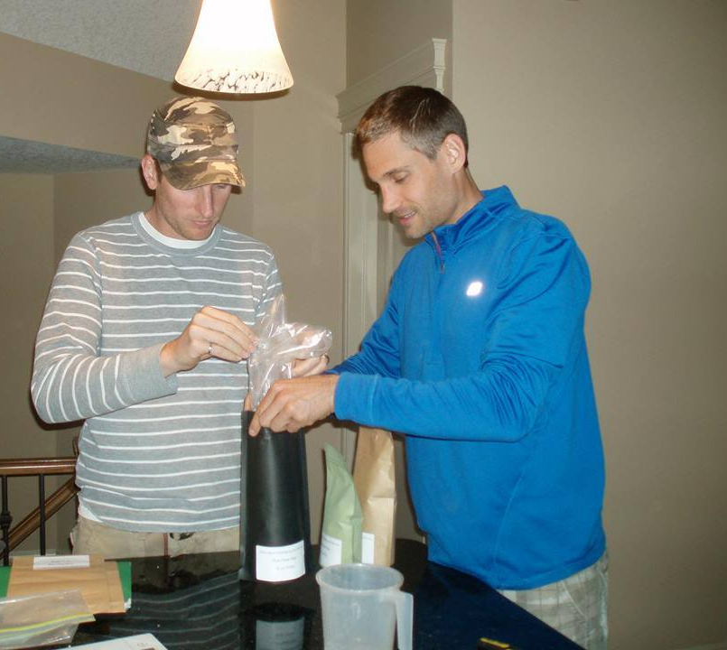
Planting the seed

Slide 4
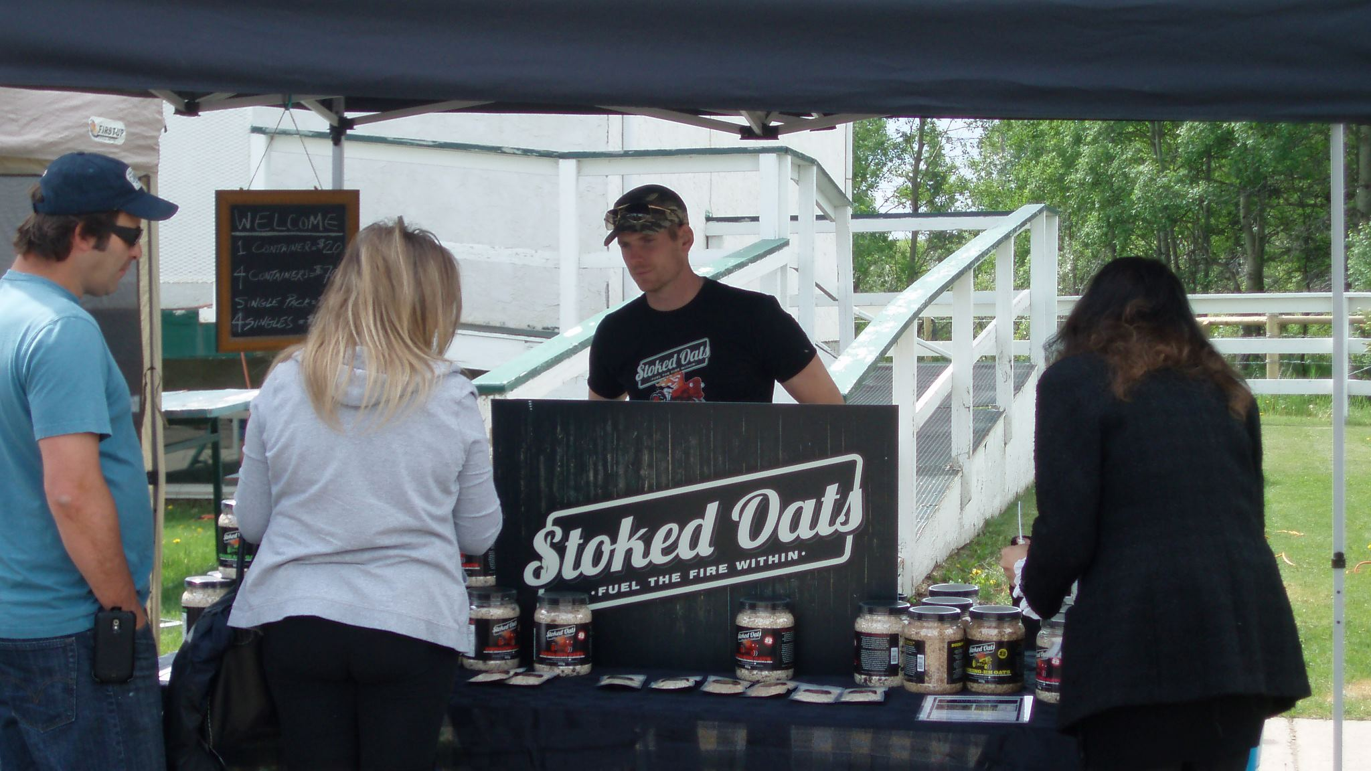
It took time
Notes:
DUPLICATE

Slide 5
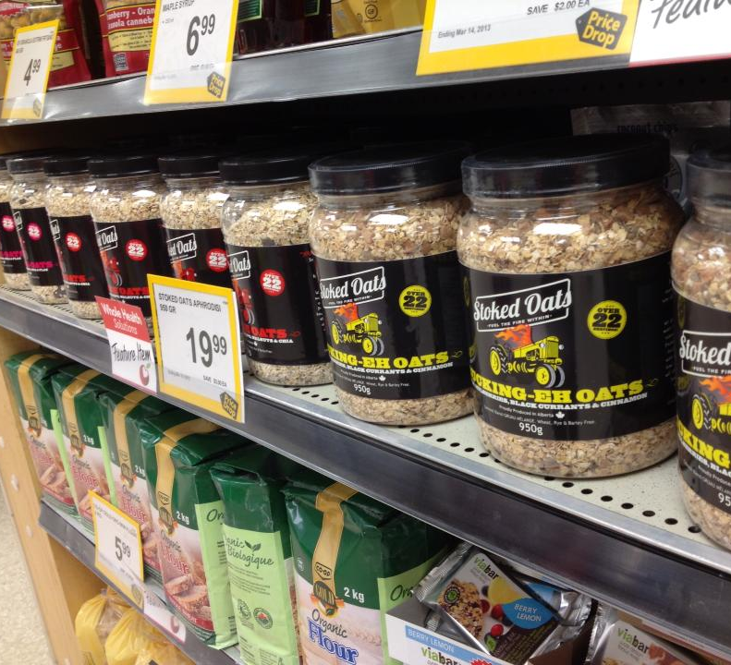
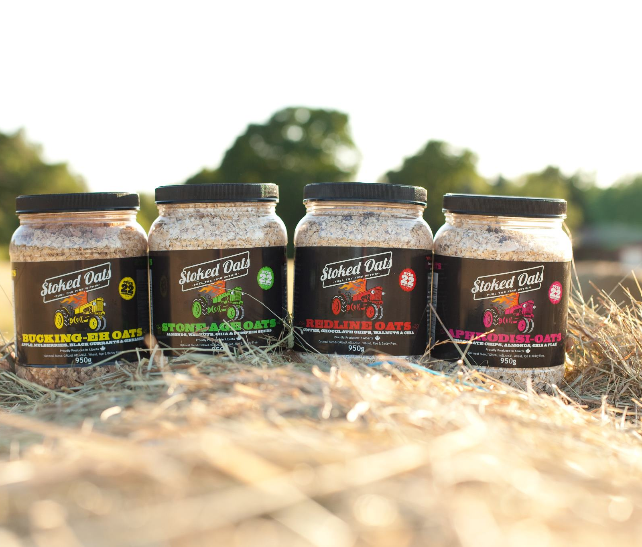
Slow and steady
Notes:
Body slide

Slide 6
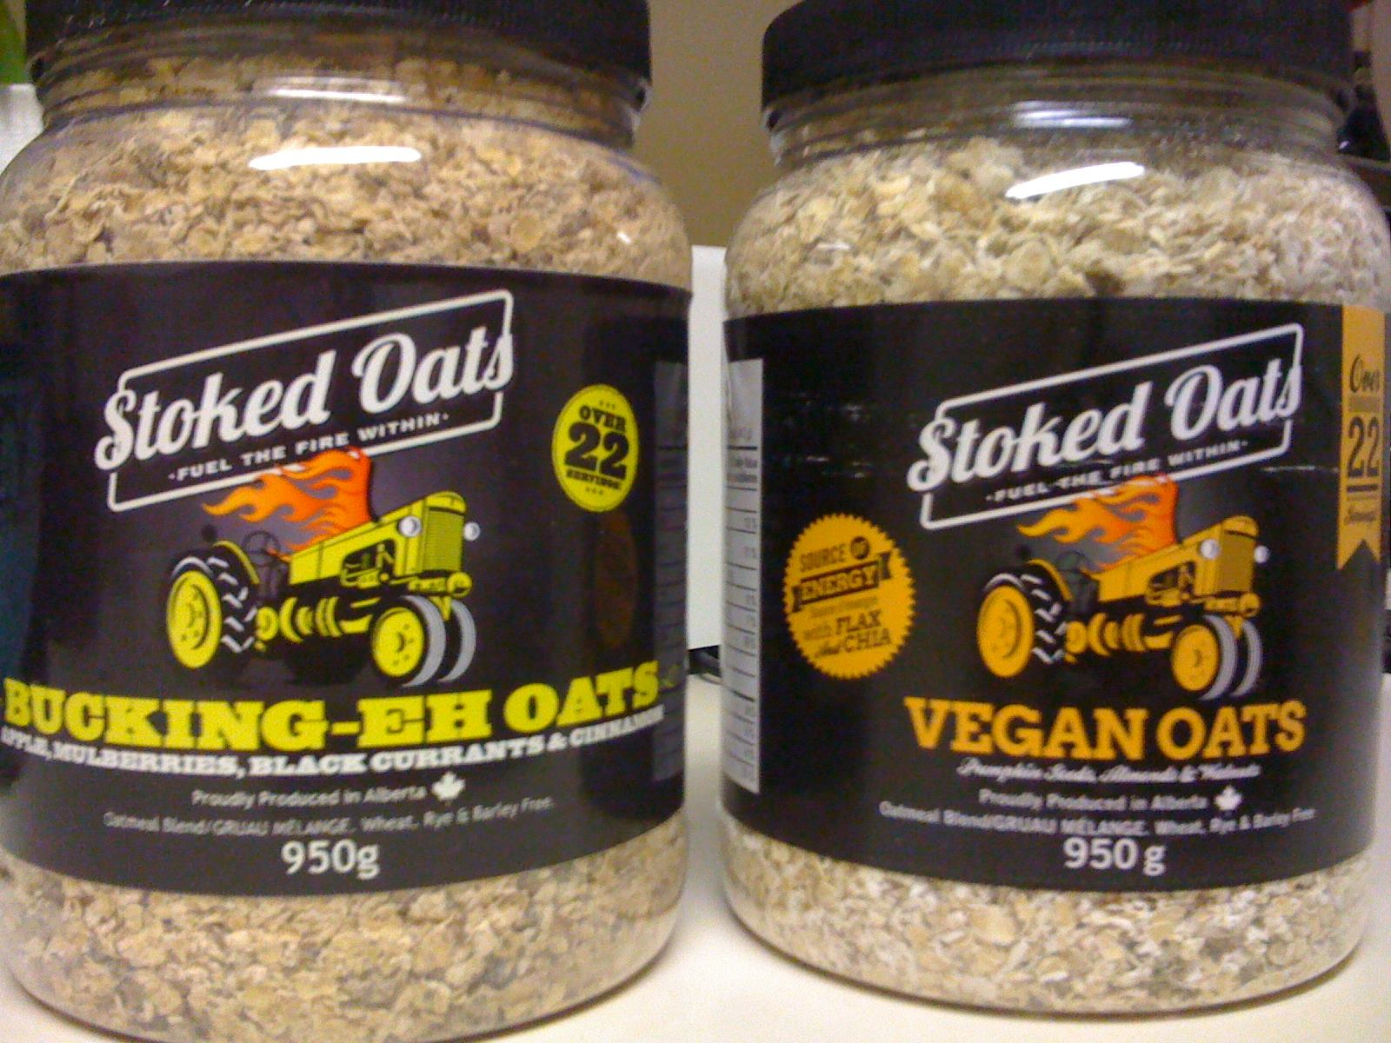
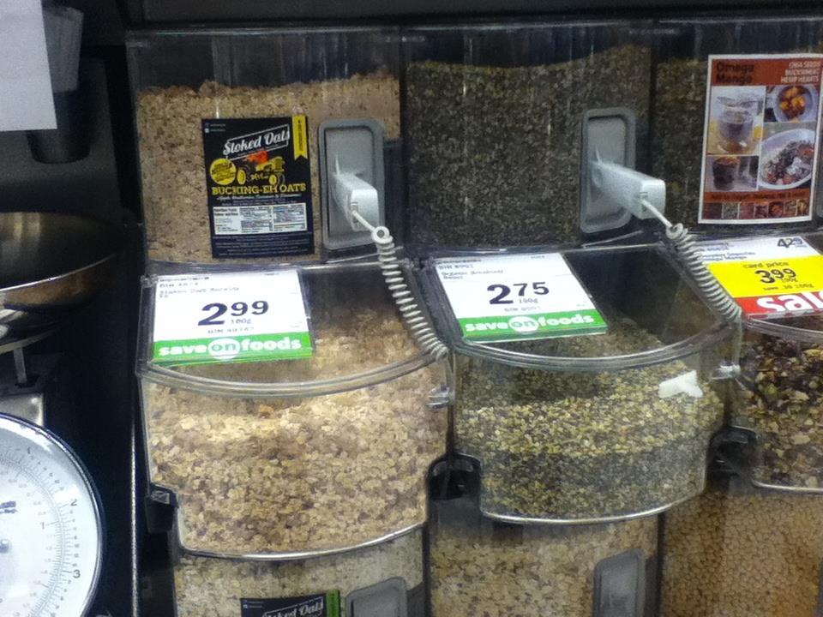
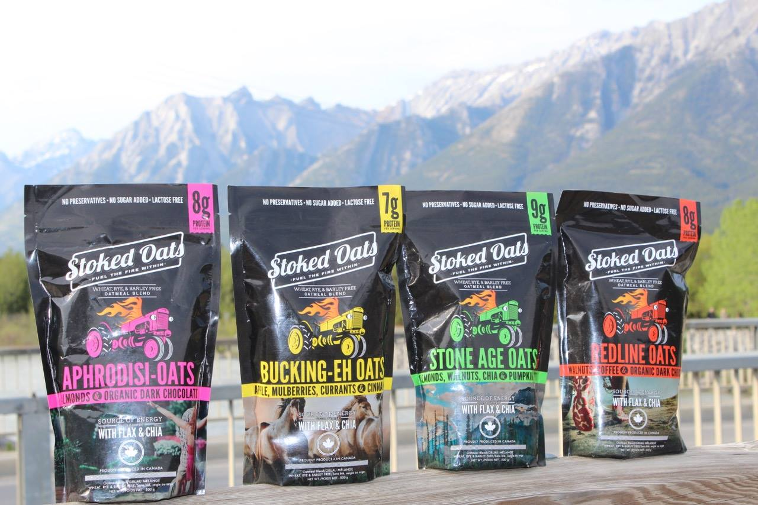
Lessons learned
Failure is only a waste if you learn nothing from it
Notes:
Body slide DUPLICATE

Slide 7
Needed money – saw some dragons
Notes:
Body slide

Slide 8
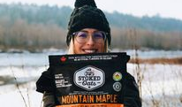
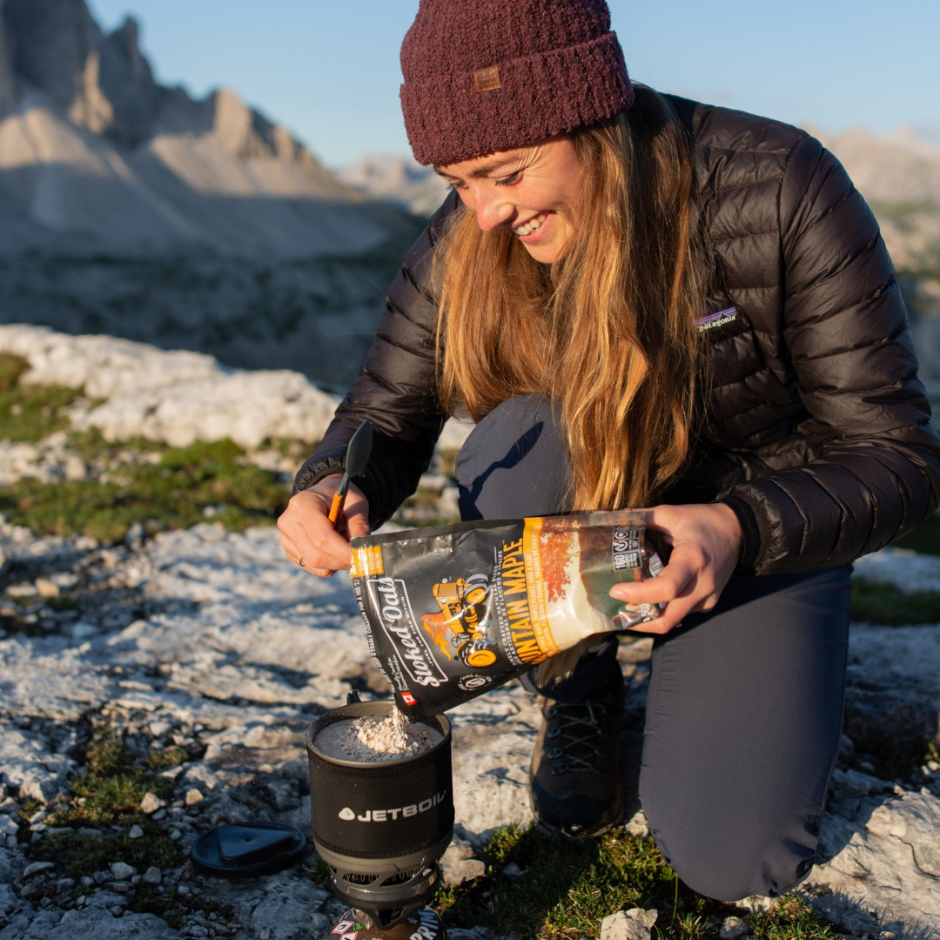
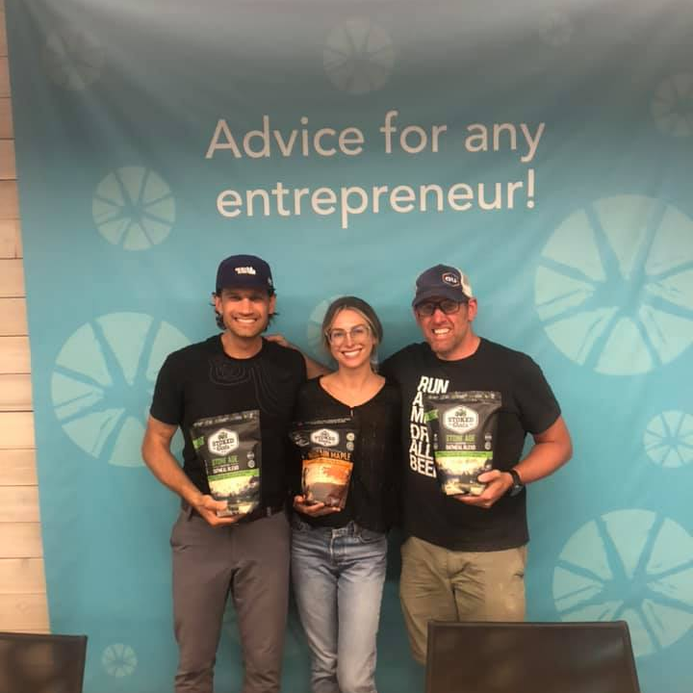
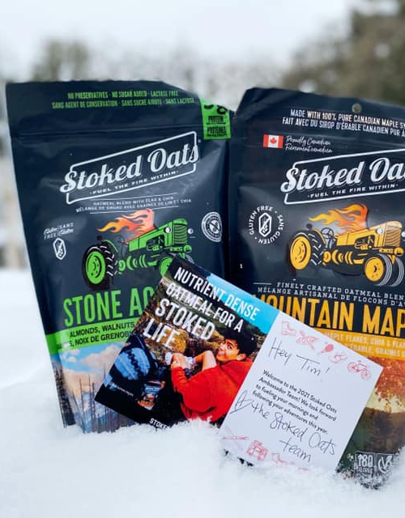
Current mood
Notes:
Body slide

Slide 9
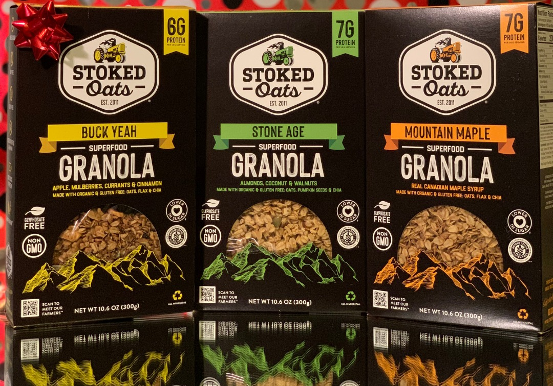
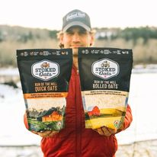
Boldly forward
Notes:
Body slide

Slide 10
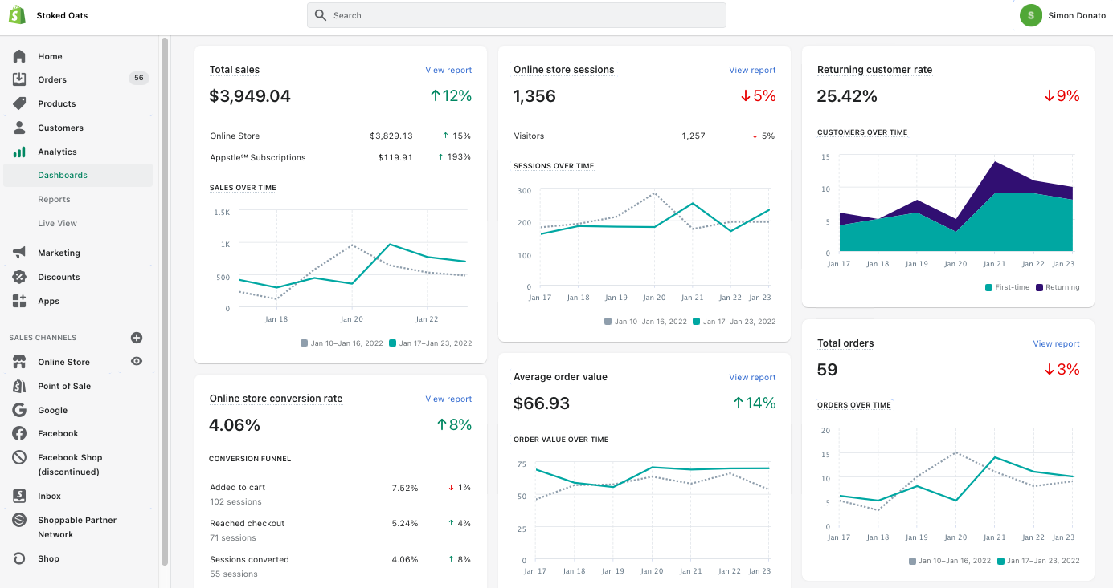
Utilizing technology
Notes:
Body slide

Slide 11
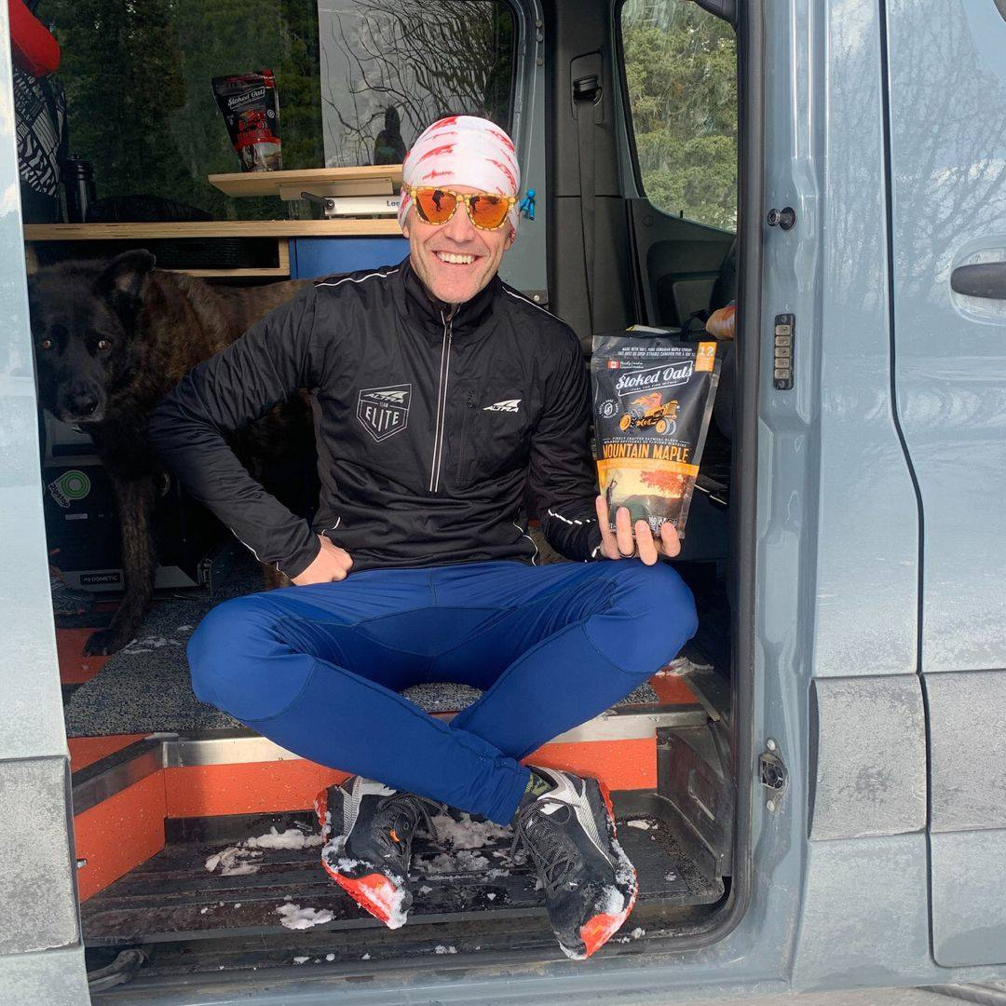
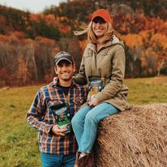
Why oats?
Notes:
Body slide

