Slide 1
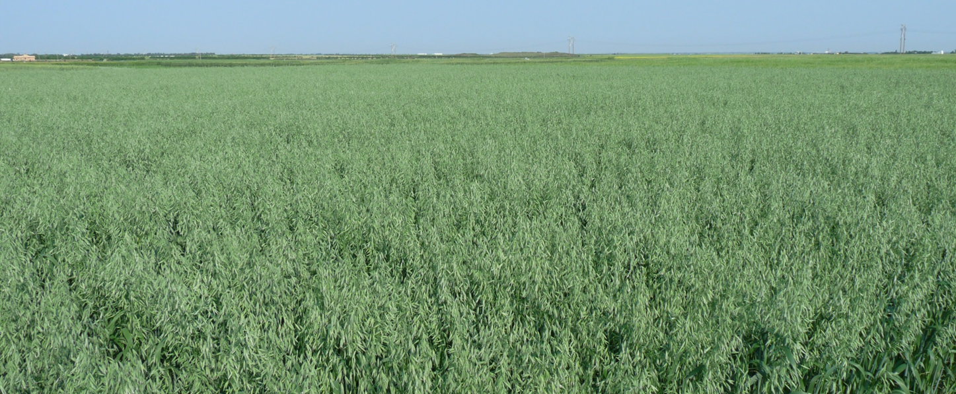

CDC Oat Varieties: What’s New, On it’s Way and Good for Alberta Producers
A.D. Beattie
Crop Development Centre
University of Saskatchewan
Edmonton, AB
January 27, 2020

Slide 2
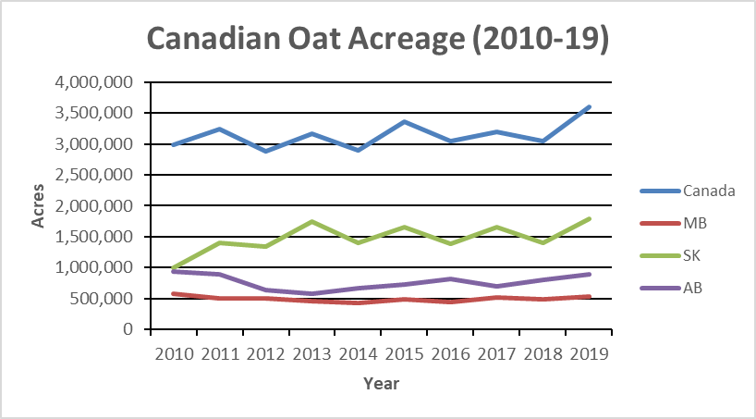
Canadian Oat Acreage
Notes:
Canadian Milling Capacity: 919,000 MT (115,000 in AB); conventional, organic (Barrhead), gluten free (Avena, MGM Seeds)
Recent expansions at Grain Millers in SK, new plant NW of Winnipeg planned from Paterson GlobalFoods (250,000 tonne capacity) next to Paterson grain terminal.
2017:
combined sales of oat and milled oat products were valued at almost $750 million last year
farm-gate sales of oat represent an estimated value of $450 million to growers
export 1.6 million tonnes/year
94% to US, 2% to Mexico, 2% to Japan
Randy Strychar (Oatinformation.com)

Slide 3
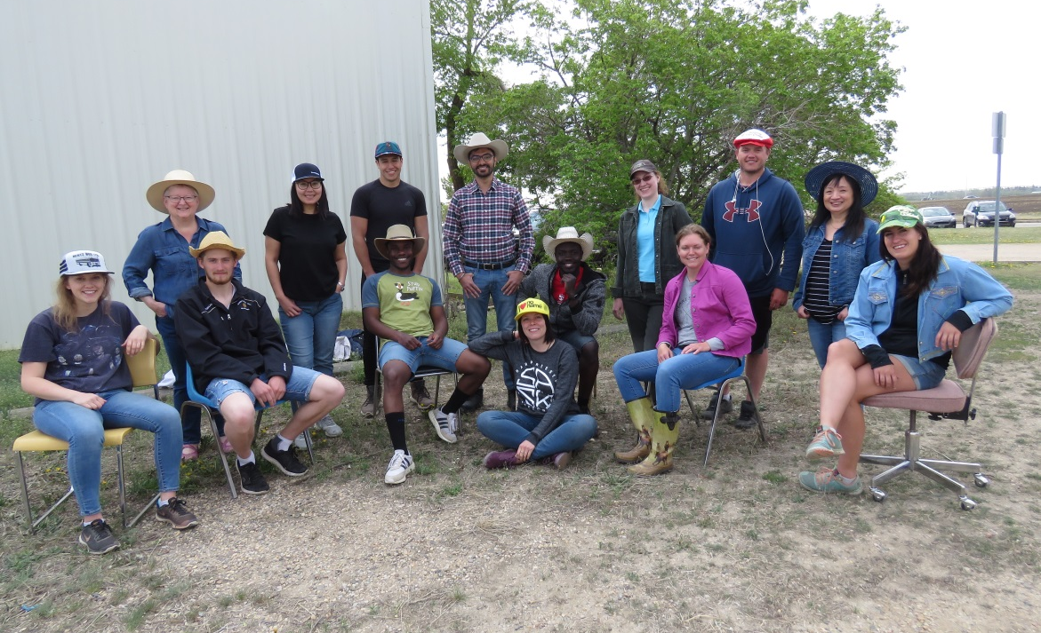
CDC Barley/Oat Breeding Staff
17 full-time staff
  2 in grain quality lab
  2 in malt quality lab
  3 in molecular lab
  1 pathologist
  9 in field lab
2 research/PDFs
7 summer students
2 graduate students
Searching for 2 additional staff

Slide 4
Oat Breeding Focus
Milling
  Expanded efforts on higher protein and stem rust resistance
  Side work on incorporating the “hairless” groat trait
Forage
  Expanded efforts on NDF digestibility and crown rust resistance
(90%)
(10%)

Slide 5
Breeding Objectives
Agronomics
  Yield
  Lodging resistance
  Maturity
Grain and Quality
  Groat percentage
  TWT, TKW, Plumpness – Uniformity
  Beta-glucan, fat, protein
Disease Resistance
  Crown rust, stem rust, smut, FHB
  Initial work on leaf blotches (Pyrenophora)

Slide 6
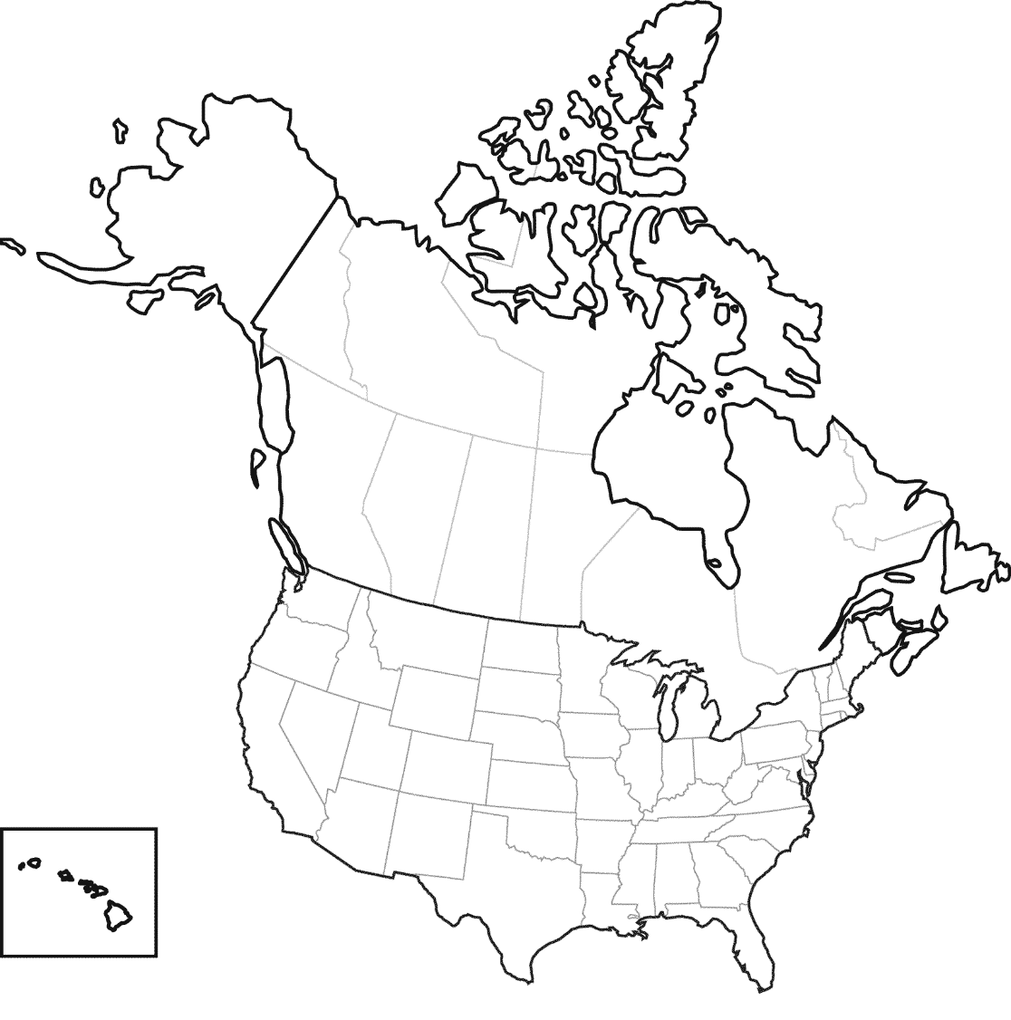
Oat Breeding Target Area

Slide 7
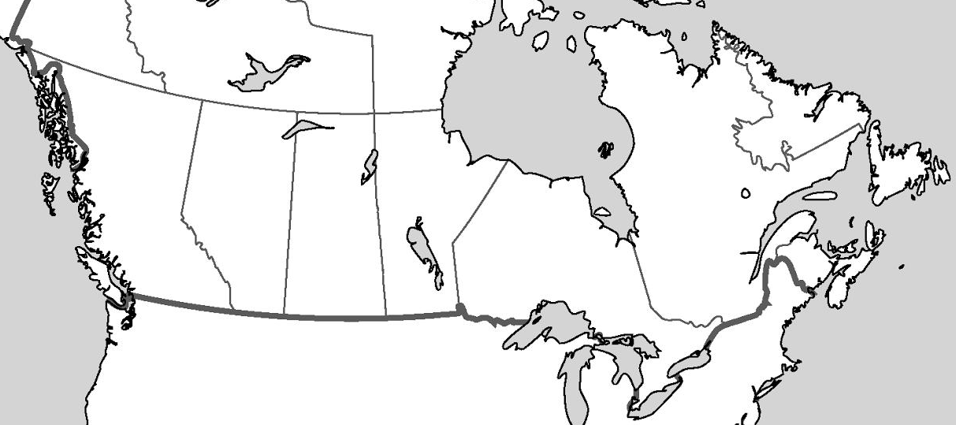
Testing Sites
Melfort
Codette
Lacombe
Saskatoon
Roblin
Brandon
Winnipeg
New Liskeard
Princeville
Portage
Ottawa
Fargo, ND

Slide 8
CDC Arborg (2016)
 | Yield | Yield as | Days to | Days to | Height |  | Test Weight | Kernel Weight | % Plump | % Thins
Entry | (Kg/Ha) | % Dan | Head | Maturity | (cm) | Lodging | (Kg/HL) | (g/1000k) | (>5.5/64”) | (<5/64”) | % Groat
CDC Dancer | 6053 | 100 | 55 | 92 | 103.5 | 3.9 | 51.6 | 41.4 | 84.3 | 5.0 | 70.0
AC Morgan | 6495 | 107 | 56 | 94 | 102.4 | 2.6 | 49.2 | 44.7 | 79.1 | 5.6 | 64.8
Leggett | 6043 | 100 | 54 | 95 | 96.5 | 4.0 | 51.9 | 42.8 | 78.9 | 5.0 | 68.6
CDC Arborg | 6919 | 114 | 55 | 93 | 105.5 | 1.4 | 50.8 | 44.9 | 82.8 | 4.0 | 69.5
Entry | Protein |  | Oil |  | β-Glucan |  |  | TDF
 | 2014 | 2015 | 2014 | 2015 | 2014 | 2015 | Mean | 2015
 | (% db) | (% db) | (% db) | (% db) | (% db) | (% db) | (% db) | (% db)
CDC Dancer | 14.5 | 15.2 | 6.5 | 7.3 | 4.8 | 4.6 | 4.7 | 9.1
AC Morgan | 14.6 | 15.3 | 6.3 | 6.8 | 4.5 | 4.4 | 4.5 | 9.7
Leggett | 16.3 | 17.9 | 7.4 | 7.6 | 5.2 | 5.2 | 5.2 | 9.9
CDC Arborg | 15.6 | 16.4 | 6.1 | 6.9 | 5.1 | 5.1 | 5.1 | 9.6
CDC Arborg (SA050479/OT595):
  Excellent lodging resistance, I to crown rust, R to smut
  White hulled
  Marketing rights to FP Genetics

Slide 9
CDC Endure (2017)
 | Yield | Yield as | Days to | Days to | Height | Lodging | Test Weight | Kernel Weight | % Plump | % Thins
Entry | (Kg/Ha) | % Dan | Head | Maturity | (cm) | (1-9) | (Kg/HL) | (g/1000k) | (>5.5/64”) | (<5/64”) | % Groat
CDC Dancer | 5934 | 100 | 53 | 96 | 103.9 | 4.7 | 52.3 | 36.9 | 88.9 | 2.7 | 79.3
AC Morgan | 6714 | 113 | 54 | 97 | 102.3 | 2.7 | 50.5 | 39.4 | 86.2 | 2.9 | 71.9
Leggett | 6105 | 103 | 52 | 99 | 96.8 | 4.8 | 52.3 | 37.8 | 86.5 | 2.7 | 76.1
CDC Endure | 6900 | 116 | 53 | 97 | 103.2 | 2.6 | 50.4 | 40.4 | 88.5 | 2.7 | 77.9
Entry | Protein |  | Oil |  | β-Glucan |  |  | TDF
 | 2015 | 2016 | 2015 | 2016 | 2015 | 2016 | Mean | 2016
 | (% db) | (% db) | (% db) | (% db) | (% db) | (% db) | (% db) | (% db)
CDC Dancer | 15.2 | 14.7 | 7.3 | 6.6 | 4.6 | 4.7 | 4.7 | 9.5
AC Morgan | 15.3 | 14.8 | 6.8 | 6.5 | 4.4 | 4.6 | 4.5 | 10.0
Leggett | 17.9 | 17.7 | 7.6 | 7.1 | 5.2 | 5.3 | 5.3 | 9.7
CDC Endure | 16.0 | 15.8 | 7.9 | 7.4 | 5.3 | 5.7 | 5.5 | 10.8
CDC Endure (OT590/CDC Dancer):
  Very good lodging resistance, MR to crown rust, R to smut
  White hulled
  Marketing rights to Alliance Seeds

Slide 10
CDC Skye (2018)
 | Yield | Yield as | Days to | Days to | Height | Lodging | Test Weight | Kernel Weight | % Plump | % Thins
Entry | (Kg/Ha) | % Dan | Head | Maturity | (cm) | (1-9) | (Kg/HL) | (g/1000k) | (>5.5/64”) | (<5/64”) | % Groat
CDC Dancer | 6368 | 100 | 53 | 96 | 108 | 4.0 | 55.0 | 38.5 | 92.9 | 1.2 | 76.0
AC Morgan | 7158 | 112 | 54 | 99 | 105 | 3.1 | 53.6 | 40.6 | 89.4 | 1.8 | 71.7
Leggett | 6503 | 102 | 53 | 100 | 99 | 3.9 | 55.0 | 38.5 | 89.8 | 1.6 | 74.6
CDC Skye | 7051 | 111 | 53 | 98 | 104 | 2.6 | 54.3 | 38.8 | 91.4 | 2.2 | 75.9
Entry | Protein |  | Oil |  | β-Glucan |  |  | TDF
 | 2016 | 2017 | 2016 | 2017 | 2016 | 2017 | Mean | 2016
 | (% db) | (% db) | (% db) | (% db) | (% db) | (% db) | (% db) | (% db)
CDC Dancer | 14.7 | 14.9 | 6.6 | 6.2 | 4.7 | 4.4 | 4.5 | 8.6
AC Morgan | 14.8 | 15.2 | 6.5 | 6.0 | 4.6 | 4.3 | 4.5 | 8.9
Leggett | 17.7 | 17.4 | 7.1 | 7.4 | 5.3 | 5.2 | 5.2 | 9.6
CDC Skye | 16.1 | 15.8 | 7.2 | 6.9 | 5.5 | 5.3 | 5.4 | 9.7
CDC Skye (OT2069/SA070860):
  Very good lodging resistance, R to crown rust and smut
  White hulled
  Marketing rights to SeCan

Slide 11
2020 2nd Year WCORT
 | Yield | Yield as | Days to | Days to | Height | Lodging | Test Weight | Kernel Weight | % Plump | % Thins
Entry | (Kg/Ha) | % Dan | Head | Maturity | (cm) | (1-9) | (Kg/HL) | (g/1000k) | (>5.5/64”) | (<5/64”) | % Groat
CDC Dancer | 6654 | 100 | 57 | 99 | 103.6 | 2.1 | 60.5 | 38.4 | 93.5 | 1.1 | 76.2
AC Morgan | 7177 | 108 | 59 | 102 | 102.9 | 1.7 | 59.7 | 42.7 | 95.1 | 0.6 | 72.5
Summit | 6910 | 104 | 57 | 104 | 92.2 | 1.9 | 60.3 | 38.3 | 91.7 | 1.8 | 75.2
CS Camden | 7117 | 107 | 57 | 99 | 94.4 | 1.4 | 58.4 | 39.5 | 92.2 | 1.6 | 72.1
OT3112 | 7134 | 107 | 60 | 101 | 86.0 | 1.6 | 59.0 | 41.1 | 94.6 | 1.0 | 76.4
OT3113 | 7065 | 106 | 59 | 102 | 97.7 | 1.4 | 57.9 | 43.7 | 97.3 | 0.3 | 74.6
Entry | Protein | Oil | β-Glucan
 | 2019 | 2019 | 2019
 | (% db) | (% db) | (% db)
CDC Dancer | 14.4 | 6.5 | 4.3
AC Morgan | 15.0 | 6.1 | 4.1
Summit | 15.6 | 7.2 | 4.7
CS Camden | 16.3 | 7.3 | 5.1
OT3112 | 15.2 | 7.0 | 6.2
OT3113 | 16.4 | 6.0 | 5.4
OT3112 and OT3113 (OT3068/CS Camden):
  Very good lodging resistance, short, R to crown rust and smut
  White hulled milling oat

Slide 12
AB Seed Guide (2020)

Slide 13
SK Seed Guide (2020)

Slide 14
CDC Forage Trials
 |  | DM Yld | DM | Height | Days to | NDF | ADF | Protein | NDFD 30 | Starch | RFV | Crown Rust
Name | Pedigree | as % Baler | % | (cm) | Head | % | % | % | % | % |  | (1-9)
CDC Baler |  | 100 | 46.3 | 88.7 | 54.2 | 53.3 | 32.8 | 9.1 | 29.6 | 20.5 | 121.0
CDC Haymaker |  | 104 | 47.5 | 85.2 | 51.8 | 55.7 | 33.8 | 8.5 | 31.8 | 18.2 | 113.5
CDC Weaver |  | 99 | 46.0 | 85.9 | 51.8 | 51.9 | 33.6 | 8.4 | 30.1 | 17.2 | 121.5
CDC Arborg |  | 97 | 52.9 | 83.5 | 49.8 | 52.2 | 32.9 | 8.7 | 32.9 | 18.6 | 121.5
CDC Nasser |  | 96 | 44.4 | 86.5 | 51.5 | 48.9 | 30.6 | 9.4 | 37.6 | 19.7 | 131.5
SA141693 | SA091901/SA080058 | 100 | 46.5 | 93.2 | 54.5 | 52.0 | 33.3 | 8.0 | 25.7 | 20.2 | 122.5 | 6
SA141705 | SA091901/SA080058 | 96 | 46.9 | 90.0 | 53.0 | 51.2 | 29.7 | 9.5 | 28.3 | 20.2 | 130.5 | 6
SA150929 | SA060078/SA081598 | 107 | 46.6 | 88.7 | 53.5 | 53.3 | 32.5 | 8.4 | 36.8 | 19.8 | 118.5 | 3
SA150938 | SA060078/SA081598 | 98 | 47.5 | 81.4 | 51.5 | 46.1 | 28.5 | 9.2 | 32.9 | 23.4 | 145.5 | 2
SA152278 | SA060078/CDC Haymaker | 107 | 45.9 | 93.1 | 53.0 | 52.7 | 33.5 | 8.6 | 30.3 | 18.8 | 119.0 | 5
SA152324 | SA060078/CDC Haymaker | 103 | 45.8 | 93.0 | 53.5 | 51.4 | 31.2 | 9.1 | 43.3 | 20.8 | 126.5 | 6
SA161744 | SA080051/CDC Morrison | 112 | 48.9 | 93.6 | 52.3 | 52.9 | 32.6 | 8.0 | 30.0 | 19.9 | 123.5 | 6
SA161756 | SA080051/CDC Morrison | 111 | 44.3 | 94.5 | 52.5 | 54.2 | 33.1 | 7.9 | 31.5 | 18.8 | 116.5 | 6
Notes:
RFV = Digestible Dry Matter/Dry Matter Intake (alfalfa in full bloom = 100)

Slide 15
Oat Research
Crown rust gene mapping (ADF/POGA)
  Collaboration with J. Mitchell Fetch, C. McCartney, J. Menzies, Kathy Klos (Aberdeen, ID)
  Map new and previously described Pc genes
  Work started on Pc40, Pc46, Pc62, Pc98
Beta-glucan markers
  High beta-glucan derived from CDC Morrison
  Collaboration with J. Mitchell Fetch and C. McCartney
  Field trials from 2016-18 at 3 locations
  Beta-glucan analysis at CDC

Slide 16
Oat Research
Oat leaf blotch (Pyrenophora) study:
  P. avenae is the most prevalent oat leaf pathogen, followed by C. sativus
  isolates of P. avenae display a range in virulence phenotypes
  resistant oat germplasm, such as OT3011, 96-21Cn19, ND061868 and Ave117.02, was identified
  a major resistance QTL explaining 63-83% of the phenotypic variation for 4 P. avenae isolates was identified from OT3011 and AC Ass/S42

Slide 17
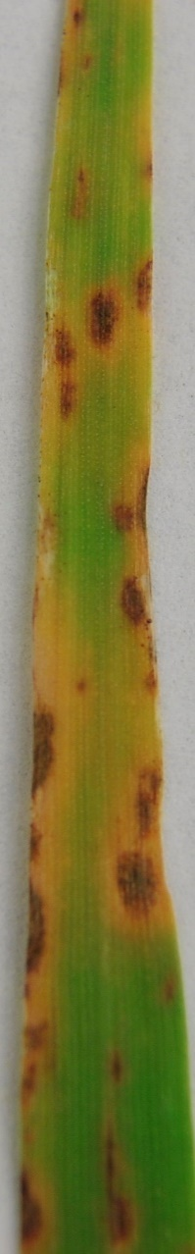
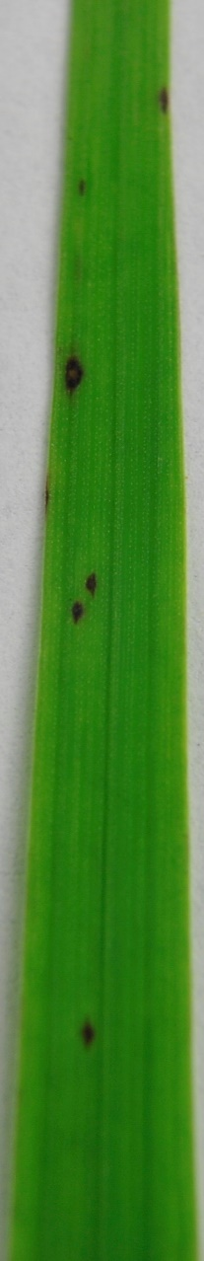
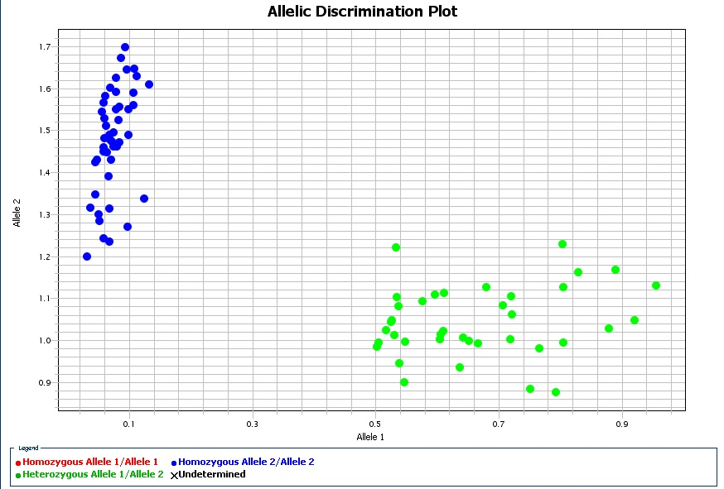
Mapping Leaf Blotch Resistance

Slide 18
Recommended Lists

Slide 19
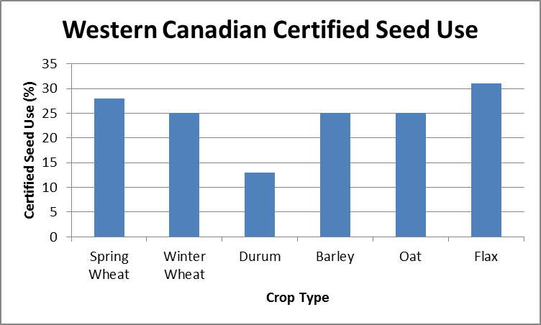
Certified Seed - Royalties

Slide 20
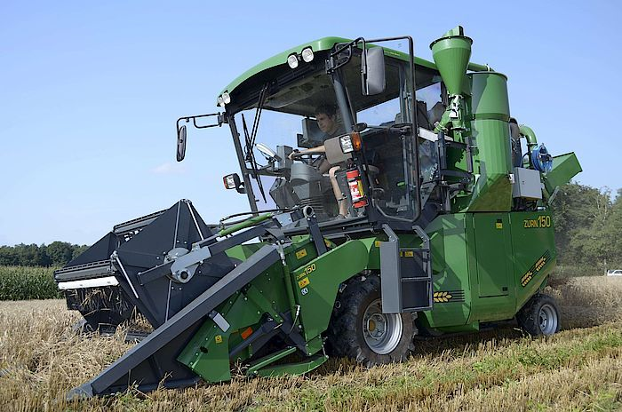
Variety Royalty Investments

Slide 21
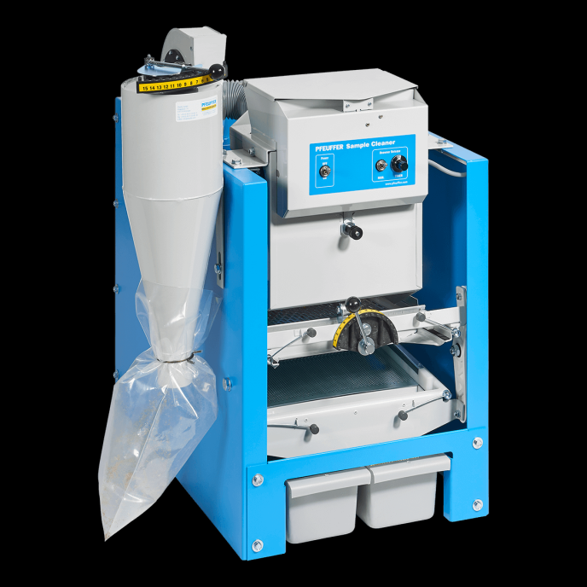
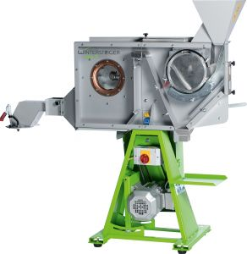
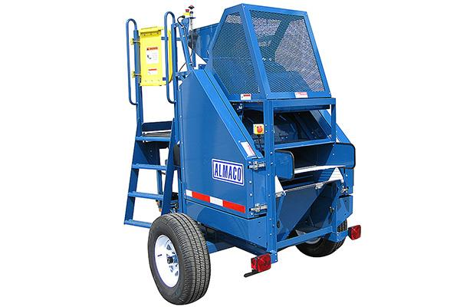
Variety Royalty Investments

Slide 22








Oat Funding Partnerships

